Slide 1
Please be seated, get a pencil, and quiet before the bell rings.
Today we’re starting an experiment … you’re in it!
What’s the purpose of education?
Notes:
Please see the last slide for a link to break down the lesson and to download the worksheets that accompany the lesson.

Slide 2
Notes:
An educated person leads a richer, fuller life than an uneducated person because they’re better at thinking, considering unexpected angles, better at listening and communicating. An educated person is dangerous, more difficult to manipulate and trick. Just because you’re in school doesn’t mean you’re getting an education. An education should challenge who you are, help you define who you want to be. An education changes the way you see yourself, how you see the world, and how you see yourself fitting in that world.
That’s why I teach. I want to give my students that educational opportunity. Mastery of mathematics is not my goal, it is the vehicle to reach the goal.

Slide 3
One of the biggest obstacles to obtaining an education in my classroom is developing student skills.
If at the end of the quarter we’re fighting to get your grade up to passing, we have failed!
Notes:
Ultimately student skills involve personal discipline, pushing your boundaries and limitations, and taking ownership of your future by taking advantage of the opportunities presented.
What wise people know is that opportunities are unseen until they’re presented. And what wisdom is, is the ability to make good decisions by thinking carefully and learning from the mistakes of others.

Slide 4
My Goal:
I want my students to be Responsible, Innovative,
Confident, Engaged and Reflective.

Slide 5
My Goal:
I want my students to be Responsible, Innovative,
Confident, Engaged and Reflective.
Responsible for themselves, responsive to and respectful of others
I want my students to take ownership of their learning, set targets and insist on intellectual integrity. They will be collaborative and supportive. They will understand that their actions have impacts on others and on the environment. They will appreciate the importance of culture, context and community.

Slide 6
My Goal:
I want my students to be Responsible, Innovative,
Confident, Engaged and Reflective.
Innovative and equipped for new and future challenges
Students welcome new challenges and meet them resourcefully, creatively and imaginatively. They are capable of applying their knowledge and understanding to solve new and unfamiliar problems. They can adapt flexibly to new situations requiring new ways of thinking.

Slide 7
My Goal:
I want my students to be Responsible, Innovative,
Confident, Engaged and Reflective.
Confident in working with information and ideas – their own and those of others
Cambridge students are confident, secure in their knowledge, unwilling to take things for granted and ready to take intellectual risks. They are keen to explore and evaluate ideas and arguments in a structured, critical and analytical way. They are able to communicate and defend views and opinions as well as respect those of others.

Slide 8
My Goal:
I want my students to be Responsible, Innovative,
Confident, Engaged and Reflective.
Engaged intellectually and socially, ready to make a difference
Students are alive with curiosity, embody a spirit of enquiry and want to dig more deeply. They are keen to learn new skills and are receptive to new ideas. They work well independently but also with others. They are equipped to participate constructively in society and the economy – locally, nationally and globally.

Slide 9
My Goal:
I want my students to be Responsible, Innovative,
Confident, Engaged and Reflective.
Reflective as learners, developing their ability to learn
Students understand themselves as learners. They are concerned with the processes as well as the products of their learning and develop the awareness and strategies to be lifelong learners.

Slide 11
Goal Setting and Monitoring
Motivation Types
Student Skills
Notes:
I am going to teach you how to set goals that you can accomplish and help you to do so. I will help you monitor and adjust your approach to realizing your goals.

Slide 12
Notes:
During the videos we’re about to watch, you will be watching, thinking and paying attention. You’ll be answering questions and using this information. This is a key way of thinking that can be used outside of the classroom, in your daily life. This is what successful people do to accomplish their goals.
Hand out worksheet

Slide 13
Notes:
https://www.youtube.com/watch?v=1-SvuFIQjK8

Slide 14
Notes:
https://www.youtube.com/watch?v=PCRSVRD2EAk

Slide 15
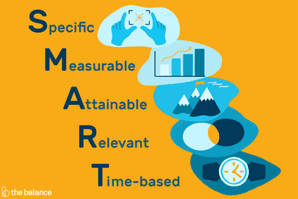
Notes:
Facilitate a discussion about smart goals and review the answers to the video sheet.

Slide 16
SMART Goal Review Sheet
Notes:
Have students examine a student smart goal and determine the validity of the SMART Goal. Does it meet the criteria of a SMART Goal? Why not?
Homework: Fix the goal on the SMART Goal sheet to be a real smart goal.

Slide 17
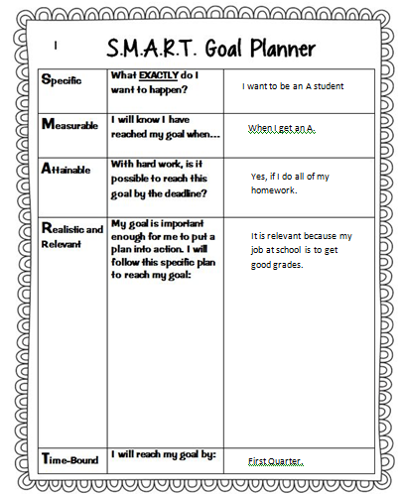
Write these questions on the paper.
Is this a good goal?
Is this a SMART Goal?
What might be done to help make this goal better?

Slide 18
End Day 1

Slide 19
Please be seated and quiet before the bell rings.
Get the SMART Goal Worksheet and be ready to discuss what you found.
Notes:
Conduct a full-class review of the homework.

Slide 20
Write these questions on the paper.
Is this a good goal?
Is this a SMART Goal?
What might be done to help make this goal better?

Slide 21
We are going to develop a deeper understanding of what it takes to earn good grades!

Slide 22
Notes:
https://www.youtube.com/watch?v=kUNE4RtZnbk

Slide 23
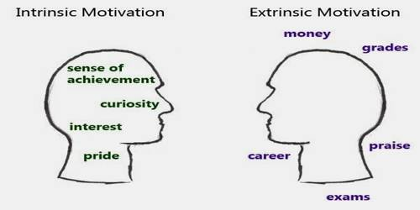
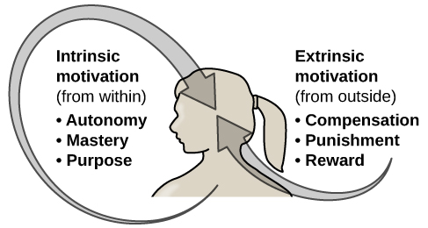

Slide 24
In this context, engagement means to be emotionally involved and committed.
Notes:
Facilitate discussion about engagement.

Slide 25
Extrinsic
Intrinsic
Shallow Engagement:
Gets work done for completion
Easily discouraged
Motivated by grades.
Deep Engagement:
Seeks understanding
Does not give up
Self-directed, owns learning
Notes:
Which do you think comes from intrinsic motivation…which from extrinsic?

Slide 26
The Key Difference …
A student that is intrinsically motivated will, over time, outperform students that are extrinsically motivated, even if the extrinsically motivated student is smarter.
Notes:
A student that is intrinsically motivated will, over time, outperform students that are extrinsically motivated, even if the extrinsically motivated student is smarter.

Slide 27
What do grades even mean?
Notes:
Discuss what grades mean… an A is mastery, a B is fluency, a C is proficiency, a D is approaching proficiency yet, and an F is not approaching proficiency. There really is not a failing grade, just a measure of where you currently are.
My commitment is to focus my feedback to you on performance, how you’re improving, what are limiting factors and such, not just the grade. The grade will take care of itself if we focus on the right things.

Slide 28
Grades
Mastery means the student could teach the material. They don’t just know how, they know what they’re doing and why.
A
Mastery
B
Fluency means that a student generally knows the material, but has conceptual gaps.
Fluency
A proficient student has demonstrated they are prepared to move forward, but perhaps should not specialize in this field.
C
Proficient
D
Not Proficient
These students need to continue to develop before taking college level material.
F
Developing
These students have a lot of work ahead. They can be successful, at a slower pace.
Notes:
We work very hard to align our grades with these principles. So if you want to know what your student needs to do to move from a C to an A… they need to develop their conceptual understanding and practice problem solving.

Slide 29
Grades
A
Mastery
A student is being successful if they resourcefully seek understanding and if, through reflection, they learn from their mistakes.
B
Fluency
C
Proficient
D
Not Proficient
F
Developing
Notes:
We work very hard to align our grades with these principles. So if you want to know what your student needs to do to move from a C to an A… they need to develop their conceptual understanding and practice problem solving.

Slide 30
Exit Ticket:
How is the view of grades you witnessed today different than how you previous considered grades?
How does the motivation to earn good grades get in the way of earning good grades?

Slide 31
End Day 2

Slide 32
Please be seated and quiet. Write and answer these questions.
How is the view of grades you witnessed yesterday different than how you previous considered grades?
How does the motivation to earn good grades get in the way of earning good grades?
Notes:
Use the example of the digeridoo to highlight intrinsic versus extrinsic.

Slide 33
What are student skills?
Notes:
Brainstorm and record what student skills

Slide 34
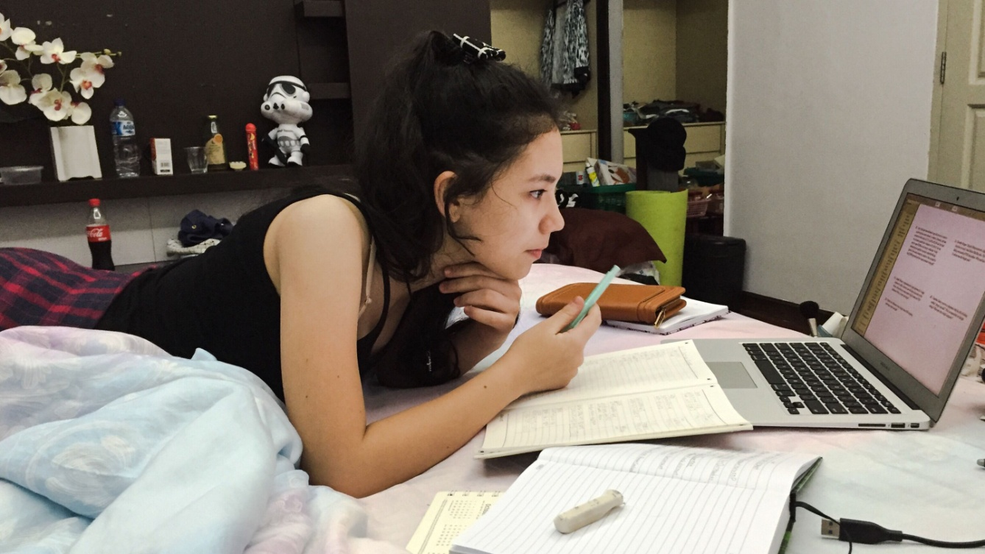
As we watch this video… note how many of our study skills were mentioned. Did the video hit them all, did it mention any we missed?
Notes:
https://www.youtube.com/watch?v=CPxSzxylRCI Study skills

Slide 35
As we watch this video… note how many of our study skills were mentioned. Did the video hit them all, did it mention any we missed?
Notes:
https://www.youtube.com/watch?v=E7CwqNHn_Ns

Slide 36
Student Skills Reference Sheet

Slide 37
Do you remember this…does it make more sense now?
If at the end of the quarter we’re fighting to get your grade up to passing, we have failed!
Notes:
Ultimately student skills involve personal discipline, pushing your boundaries and limitations, and taking ownership of your future by taking advantage of the opportunities presented.
What wise people know is that opportunities are unseen until they’re presented. And what wisdom is, is the ability to make good decisions by thinking carefully and learning from the mistakes of others.

Slide 38
Useful
Notes:
Have students explain if they believe the past three days’ activities will be useful for them, if it will help promote their academic success and so on . Sell them on the assignment that is next.

Slide 39
Day 4

Slide 40
Please get your SMART Goal Sheet.
Make a SMART Goal that focuses on the development of a student skill.
Why focus on student skills?
Notes:
Have students fill out the smart goal sheet using the student skills list as a reference sheet. Allow 10 minutes

Slide 41
Feedback
Notes:
With a neighbor, switch smart goals and evaluate how they’ve done. Is something missing? Could they pick a supporting student skill as a goal? For example, organization supports time management. Organization is easier to learn.

