Slide 1
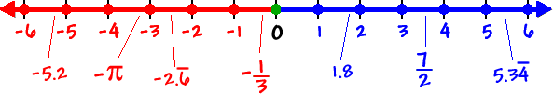

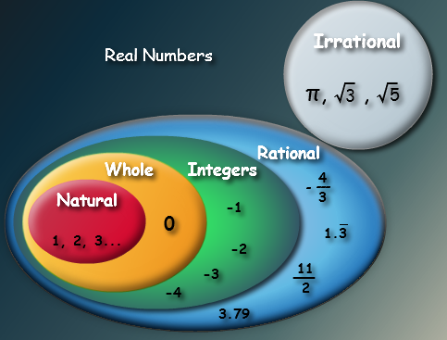
Real Numbers and Their Properties

Slide 2
The Number Line …
It is a solid line, without spaces or gaps. However, without one of the types of Real Numbers, the line would be discontinuous (it would have gaps).
There are a few types of Real Numbers and there are also numbers that are not real. They are not on the Real Number Line.

Slide 3
REAL
Notes:
Real, in math is probably not what you’d expect. So let’s talk about what it means and see if that can shed some light on the situation.

Slide 4

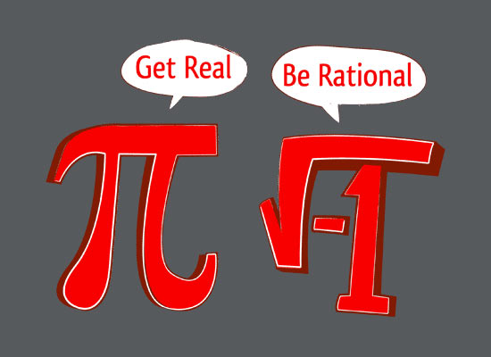
Real numbers are numbers that are not imaginary.
REAL
Notes:
Real numbers are numbers that are not imaginary. Still not clear. Imaginary numbers are numbers involving the square root of -1.

Slide 5
Real numbers are numbers that are not imaginary.
REAL
Notes:
Real numbers are numbers that are not imaginary. Still not clear. Imaginary numbers are numbers involving the square root of -1.

Slide 6
Properties of Real Numbers
The Commutative Property says the order in which you add or multiply does not change the value.
If a and b are real numbers, would it be true that:
a – b = b – a?
If a and b are real numbers, would it be true that:
a + b = b + a?
What if the were negative numbers?
Does this work with multiplication and division, too?

Slide 7
Properties of Real Numbers
The Associative Property says the way in which you group addition or multiply does not change the value.
What about subtraction?
If a and b and c are real numbers, would it be true that:
(a + b) + c = a + (b + c)
Would this work for multiplication?

Slide 8
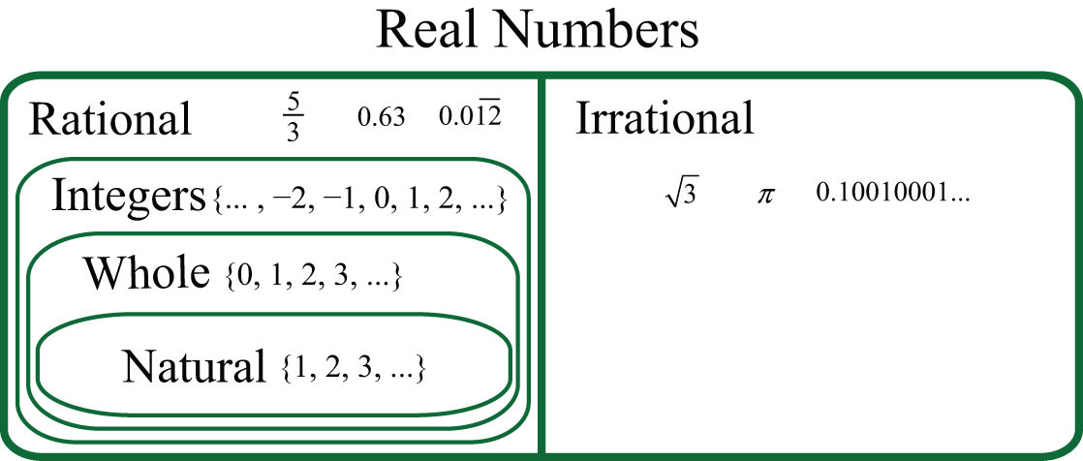
What about zero… is zero rational?
Notes:
We can break the real numbers into two categories. Rational and Irrational. Rational numbers are fractions, specifically, a ratio of an integer and a natural number.

Slide 9
Approaching Infinity …
Infinity is an idea, not a number. The idea is that infinite things are not bound, their number continues to grow so long as you continue to look.
Is Infinity a number?
How many natural numbers exist?
To find the next natural number, you simply add one to it. The set of Natural Numbers is infinite.

Slide 10
Suppose the set of Natural Numbers was finite
(not infinite).
Are the integers an infinite set of numbers, too?
There are different sizes of infinities!
Take the largest number and multiply it by itself and you have just found a larger Natural Number.
Are there the same number of integers and natural numbers?

Slide 11

What about zero… is zero rational?
First big idea: Division really asks a question.
b times what equals a?
Don’t think, “Ten divided by five,” think, “Five times what is ten?”
This is true, not because your teacher said so, but
because 5 x 2 is 10.
If b times a equals c, then it must be true that b x c = a.

Slide 12
What about zero… is zero rational?
First big idea: Division really asks a question.
Think, “Seven times what is zero?”
Zero times everything is zero. So a zero divided by a number is zero because …
Think of it as, “Five times what is ten?”
This is true, not because your teacher said so, but
because 5 x 2 is 10.
Seven times zero is zero.

Slide 13
Zero times everything is zero. So a zero divided by a number is zero because …
This number times what is zero?
Is there a number times zero that equals something other than zero?

Slide 14
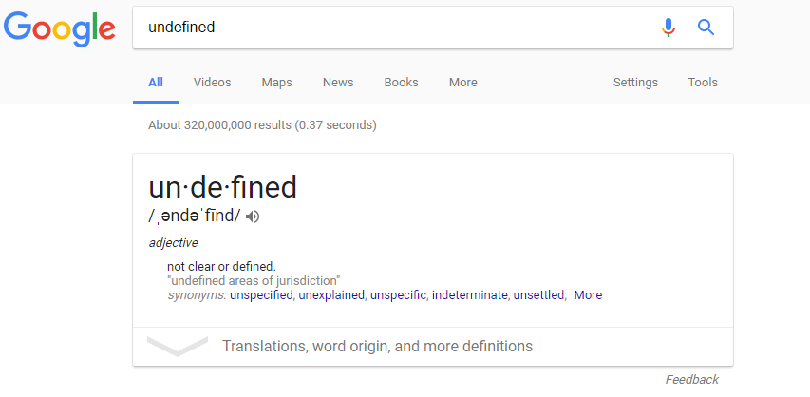
Zero is defined … it means the absence of value.

Slide 15

This is asking us, “Zero times what is fifteen?”

Slide 16
Why are repeating decimals rational?

Slide 17
Why are repeating decimals rational?

Slide 18


Why are repeating decimals rational?
Let’s look at how this works, to gain some insight.
Our number system is base 10, and decimals are fractions with a denominator that is a power of 10.
ten thousandths
tenths
thousandths
hundredths

Slide 19
Some rational numbers work great as decimals.
Some rational numbers don’t work great as decimals.
This says, “Three times what is ten?”
This says, “Four times what is ten?”
This will never stop! There isn’t an integer times three that is ten!
Our math is base 10. This sometimes causes problems rewriting those integers in a ratio with a power of ten.
Problem is, this isn’t a rational number. Why?
How can we fix it?
Notes:
The purple box … a rational number is the ratio of two integers. 2.5 is not an integer. The blue box … sometimes changing fractions is done for reasons other than common denominators.

Slide 20
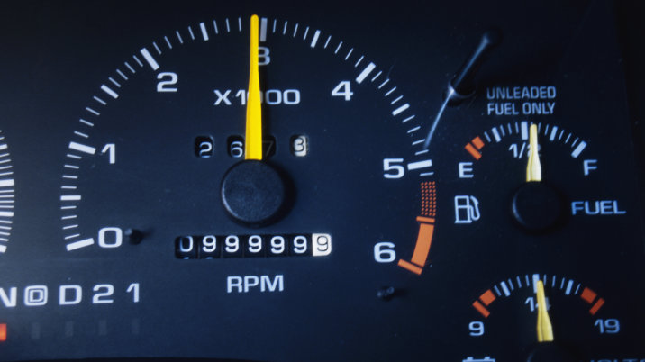
What base ten means in math is there are ten numbers, (0 through 9) that fill up space before it “ticks” over to the next space.
Our spaces for whole numbers are ones, ten, hundreds, thousands and so on… all powers of ten again.

Slide 21


There are other bases of math that we know.
Inches to feet … that’s base 12 math.
Minutes and seconds are base 60 math.
Hours, though, that’s base 24.

Slide 22
If you had 38 seconds out of a minute and converted that on a calculator, you might just type in 0.38, but you’d be wrong.
38 seconds is 0.6333… of a minute!
0.38 of a minute is almost 23 seconds.

Slide 23
Can you write 6 inches as a part of a foot in a decimal?
What about converting 5’ 8” into a decimal of feet?
6 inches is 0.5 of a foot.
and 5’ 8” is 5.66666… feet.

Slide 24
How many hours and minutes is 1.75 hours?
Well, 0.75 is three fourths…three fourths of an hour is 45 minutes.

Slide 25
What about converting repeating decimals into fractions?
The following step is done by a procedure learned with solving systems of equations, which will be covered later. (In fact, this procedure would be a great topic to review when systems of equations is learned.)
We don’t know what number, as a fraction is , so we will write the unknown x.
Equation 1
Subtract Equation 1 from Equation 2.
Equation 2
Solve for x.
Since is repeating after the hundredths place, we will multiply both sides of the equation by 100.
(note, for 0.333333… we would multiply by 10, since the decimal repeats after the 10ths place, but we would multiply 0.457457457457…by 1,000 since it repeats after the thousandths place.)

Slide 26



Thebeardedmathman.com

