Slide 1
Reading Math to Promote Fluency and Recall
Notes:
Do not tell students they will be factoring!

Slide 2
FACT:
If what we do in class today does not promote your ability to perform in the future, we have wasted our time.
Notes:
Use this slide to focus students and establish the day’s expectations. The expectations are: 1. They try the problems, 2. stay on task during discussions, 3. do not speak out of turn 4, listen to the reasoning of others, 5. Write down things they realize.

Slide 3
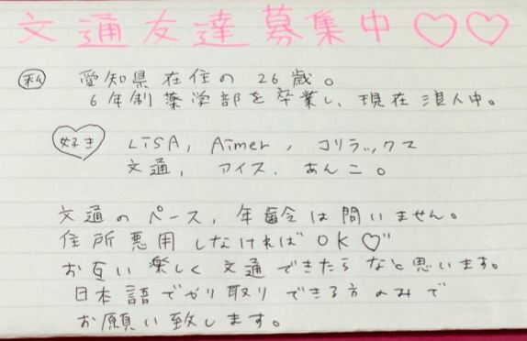
Notes:
Discuss how we can try to make sense of this, but since we can’t read Japanese, we’re probably wrong with most things we think about it.

Slide 4
HIDE THIS SLIDE:
We can help students to see the math by asking questions in a different style than they’re used to.
Focus on making them read the instructions written in English first, and then make sense of the math to be performed. Do not translate or verbalize the instructions in any way. Force them to read.

Slide 5
Notes:
Ask students how they know their answer. Don’t be satisfied with how they know their answer is right. “What clue told you it was 4?” Some kids will guess numbers and check…look for a student who knew it was four because they recognized that factoring was taking place.
This problem won’t take long for students to answer, the value comes from the discussion.

Slide 6
Notes:
Have students spend a minute or two on this. Do NOT allow them to sit and wait. For the lesson to be meaningful, they must try the problem.

Slide 7
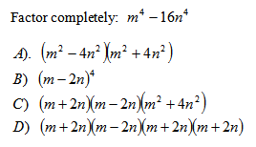
Notes:
Do a poll…raise of hands of they think the answer is A, B, C, D in succession.
Pick a student who thinks the answer is A. Have them explain why. Find a student who thinks A isn’t the answer. Ask them if they think A is equal to the original problem.
Repeat throughout the other solutions. Students will change their answers and reasoning.

Slide 8
Cognitive Dissonance
If you’ve been changing your mind or feel unsure about your answers and thinking, you’re feeling cognitive dissonance.
It’s a bit unsettling because you’ve discovered that a previously held belief is either wrong, or is of questionable foundation.
You’ll feel better when you either replace the ill-founded belief with the truth, or you’ll discover the foundation for your old belief.
This is what learning feels like. Learning cannot take place without cognitive dissonance.
Notes:
Discuss what the students are experiencing and how this activity promotes learning by making them challenge what they think. Math is not about answer getting, it’s about understanding and applying concepts. Sometimes the “right” answer can be found by chance. But that’s not a repeatable occurrence, thus it’s not math.

Slide 9
Notes:
Ask what they’ve learned…ask them to write down what they’ve learned. Without the language and articulation, their ability to remember is greatly compromised.

Slide 10
Take-Aways?
Notes:
Discuss and notate things that students observed and discussed.

Slide 11
My Biggest Take-Away
The sum of squares is not factorable but the difference of squares is factorable. Do you now really know why?
It’s super easy to mix these facts up without the understanding, but it’s clear otherwise.

Slide 12
Instructions: 1) Solve the problem below. 2) Write the mathematical fact/relationship being targeted by this problem. How does the problem relate to that fact?
Remember, getting an answer, even the right one, is not as important as understanding how to get the answer.
Notes:
The fact being enforced here is that (x + d)^2 is a perfect square. If ax^2 + bx + c is a perfect square, then “half of b-squared” will equal c. The idea is to get students to notice and articulate that fact.

